Slide 1
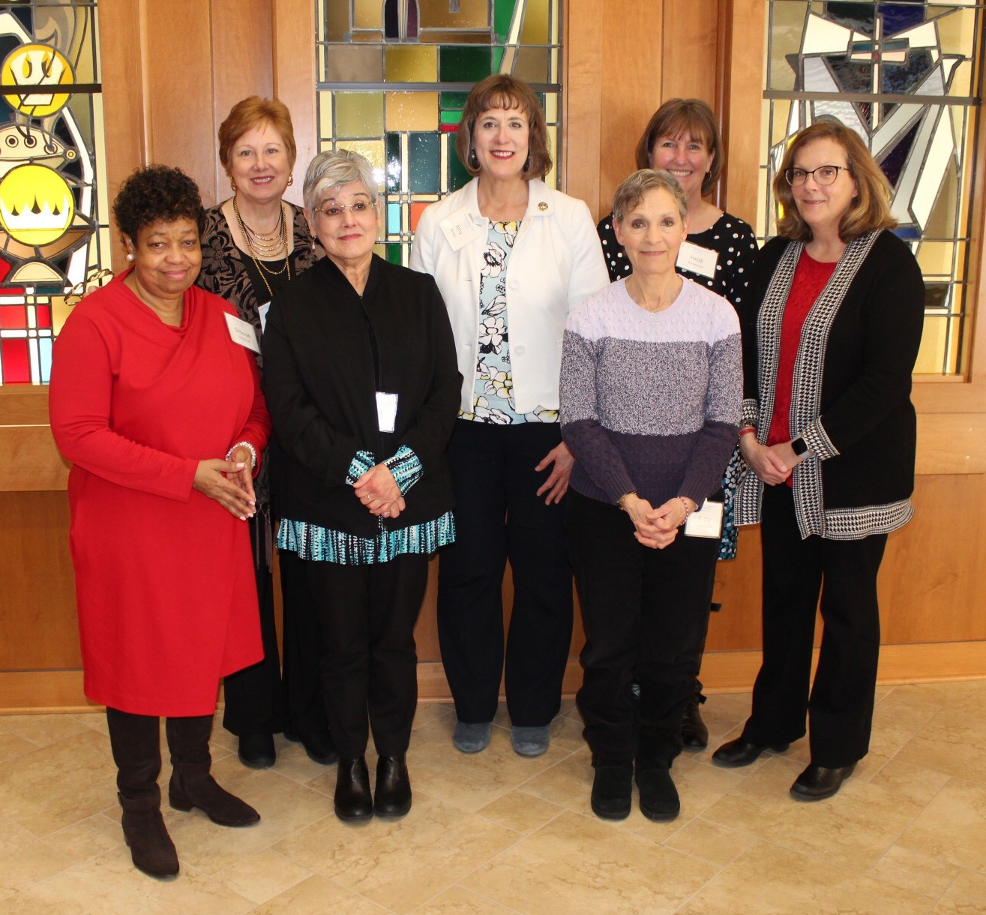
Foundations of Faith Community
Nursing and Health Ministry Preparation
Sponsored by the Faith Community Nurse Network of the Greater Twin Cities--37.5 Professional Continuing Education Credits for RNs ANCC Approved: CE valid in 50 states!
Course description: This course is required as preparation for RNs seeking to practice as Faith Community Nurses (FCNs). It is based on the curriculum developed through the Westberg Institute for Faith Community Nursing which is owned by the Spiritual Care Association of New York, NY.
LPNs, Pastors and other Faith Leaders are welcome to attend to prepare them for Health Ministry.
Faith Community Nurses are actively licensed RNs who focus on whole-person health and the intentional care of the spirit. Health ministers are
members or staff of a faith community who plan and organize programs to promote health in their community. FCNs and Health Ministers are of all faiths and practice in many different settings.
Fall, 2024 Dates
Saturdays- 9/14, 9/21, 10/26
8:00 a.m.-2:00 p.m (Central)
and
Fridays- 10/11,10/25, 11/8
8:00 a.m.– 4:00 p.m. (Central)
All 6 sessions are required
Register at:
https://form.jotform.com/fcnntc/Fall2024Foundations
Fee: $435
(plus cost of the participant manual)
Includes a virtual mentoring session.
Need-based scholarships available
We reserve the right to cancel if
registrations are below our minimum.
Full refund in that case.
Course content: Beginning Your Ministry; Prayer; Spiritual Care; Health Promotion; Legal and Ethical Issues; Documentation; Grief and Loss; Behavioral Health; Assessment; Transitional Care, Trauma,
Substance Abuse and others.
Course Methods: Advanced degree faculty includes FCNs who share real-life situations. Interaction and sharing by students is encouraged. Our student evaluation ratings average in the 95 percentile for both content and instruction quality!
See faculty bios at www.fcnntc.org.
Contact hours: 37.5 contact hours for RNs. This course is jointly provided by FCNN and the Spiritual Care Association Nursing Division. The Spiritual Care Association Nursing Division is accredited as a provider of nursing continuing professional development by the American Nurses Credentialing Center's Commission on Accreditation. ANCC Provider Unit # P0623.
Our students say:
“Excellent course based on best evidence” “Expert faculty” “Real stories from faculty so helpful.” “Very relevant to FCN practice” “This course was life-changing for me!”
Questions?
Contact Lead Faculty, Sondra Weinzierl Sondra@fcnntc.org or 763-478-1027
Or call the FCNN office at 651-204-0904
https://www.fcnntc.org/ 3530 Lexington Avenue N. Shoreview, MN 55126

