Slide 1
Depression in Older Adults: Assessment, Programming & Resources
Neal C. Buddensiek, MD, CMD, HMDC, WCC
March 16th, 2023

Slide 2
Relevant Disclosures:
I have nothing to disclose

Slide 3
Learning Objectives:
Explain the importance of early detection for older adults living with depression
Explain the importance of depression treatment
Identify the preferred depression screening tool
Explain the importance of educating older adults on depression
Understand the critical need for a practical crisis (suicide) protocol

Slide 4
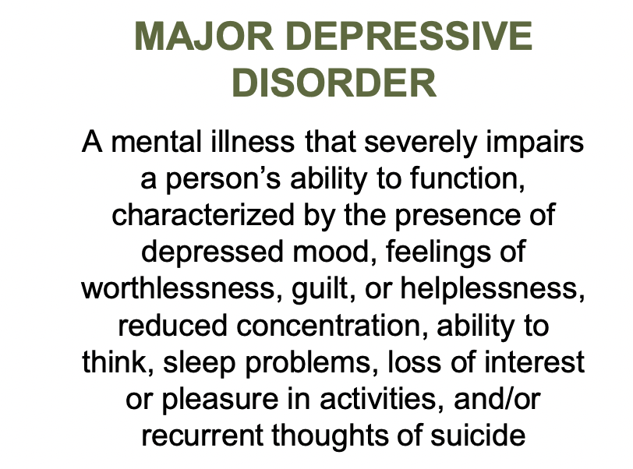
What Depression is (and is not)?

Slide 5
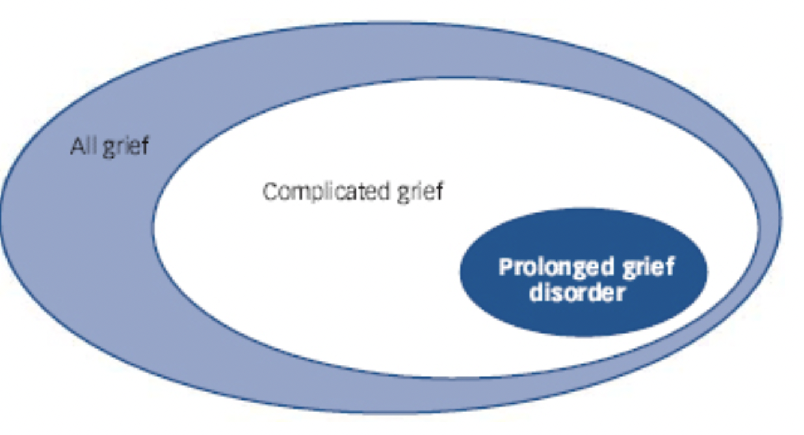
Differences Between Sadness, Grief and Depression
“Sadness” is a natural, healthy human emotion
“Grief” is a normal reaction to a tremendous loss

Slide 6
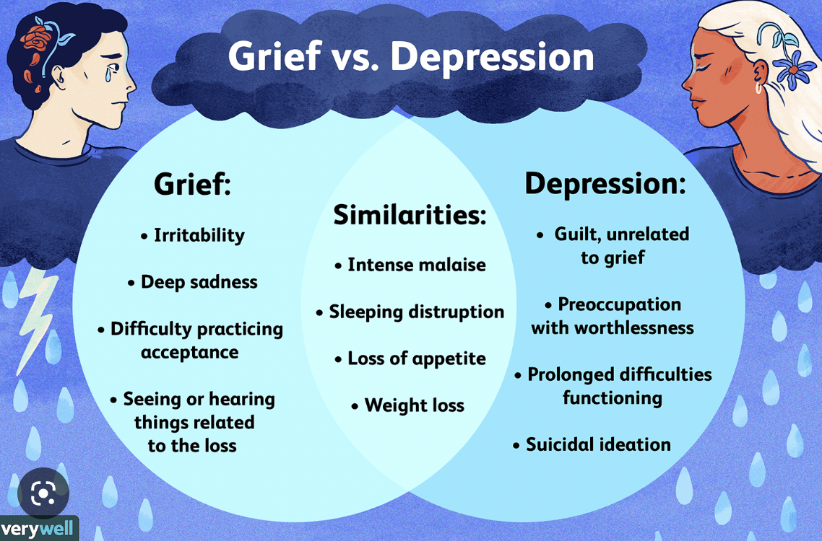
Differences Between Sadness, Grief and Depression

Slide 7
How Common is Depression in Older Adults
Healthy independent community-dwelling older adults in the US have a lower prevalence rate of depression than the general adult population
Approximately 2 - 10% (cultural factors and variations in methods of assessment lead to significant variations in reported prevalence)
Higher rates for older adults with comorbid medical illness
Adults >85 yrs old may be underestimated, yet may have increased prevalence of depressive symptoms (few epidemiologic studies exist)
As many as 50% or more of nursing home residents are depressed

Slide 8
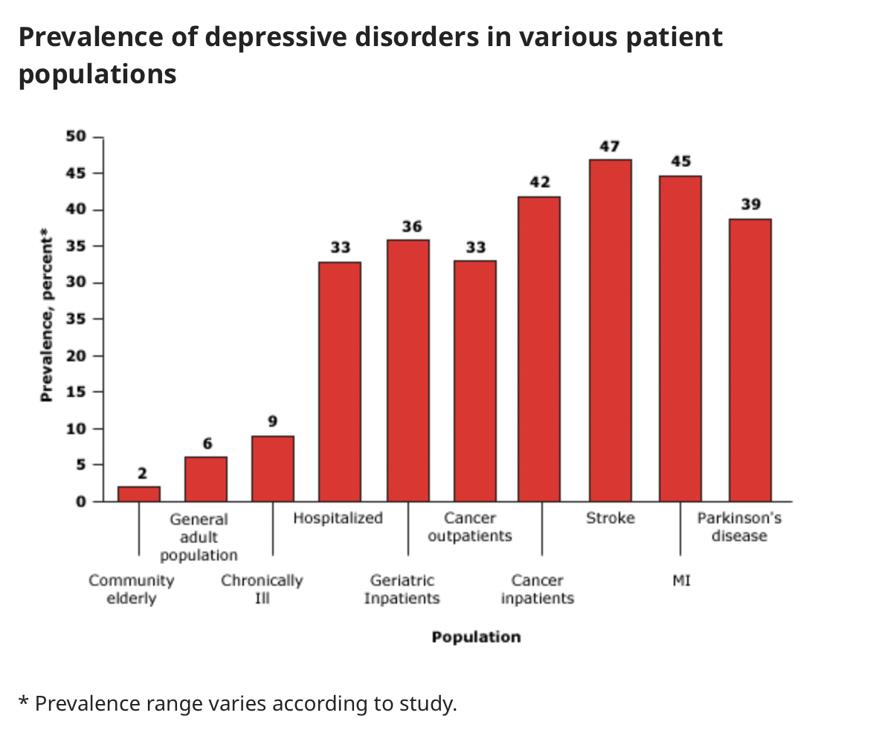

Slide 9
Risk Factors for Depression
Female
Social isolation
Widowed
Divorced or separate marital status
Lower socioeconomic status
Comorbid medical conditions
Uncontrolled pain
Insomnia
Functional impairment
Cognitive impairment

Slide 10
The Importance of Early Detection of Depression
Treatment CAN be EFFECTIVE!
Beneficial effects on health outcomes (such has chronic pain, diabetes, osteoarthritis)
Left Untreated
Outcomes are worse compared to younger adults
Higher rates of morbidity (amplifies disability and lessens quality of life)
Higher rates of mortality (including suicide)
Increased drug use (alcohol and illicit drugs)
Increased healthcare utilization (office and ED visits)
Increased economic costs

Slide 11
Depression and Risk of Suicide
Older adults account for approximately 13% of population of US, but nearly 24% of all completed suicides.
Older adults attempt suicide less often than younger people, but are more successful at completion.
Older adult men have the highest suicide rate. White men age 85 or older have the highest rate of completed suicide. Most older adults dying by suicide were in their first episode of depression and had seen a physician within the last month of life.
Acute Risk for Suicide: hopelessness, insomnia, agitation/restlessness, impaired concentration, active psychosis, active alcohol use or intoxication, untreated pain, terminal illness/worsening illness, widowhood/social isolation, personality disorders, prior suicide attempt, family history of suicide

Slide 12
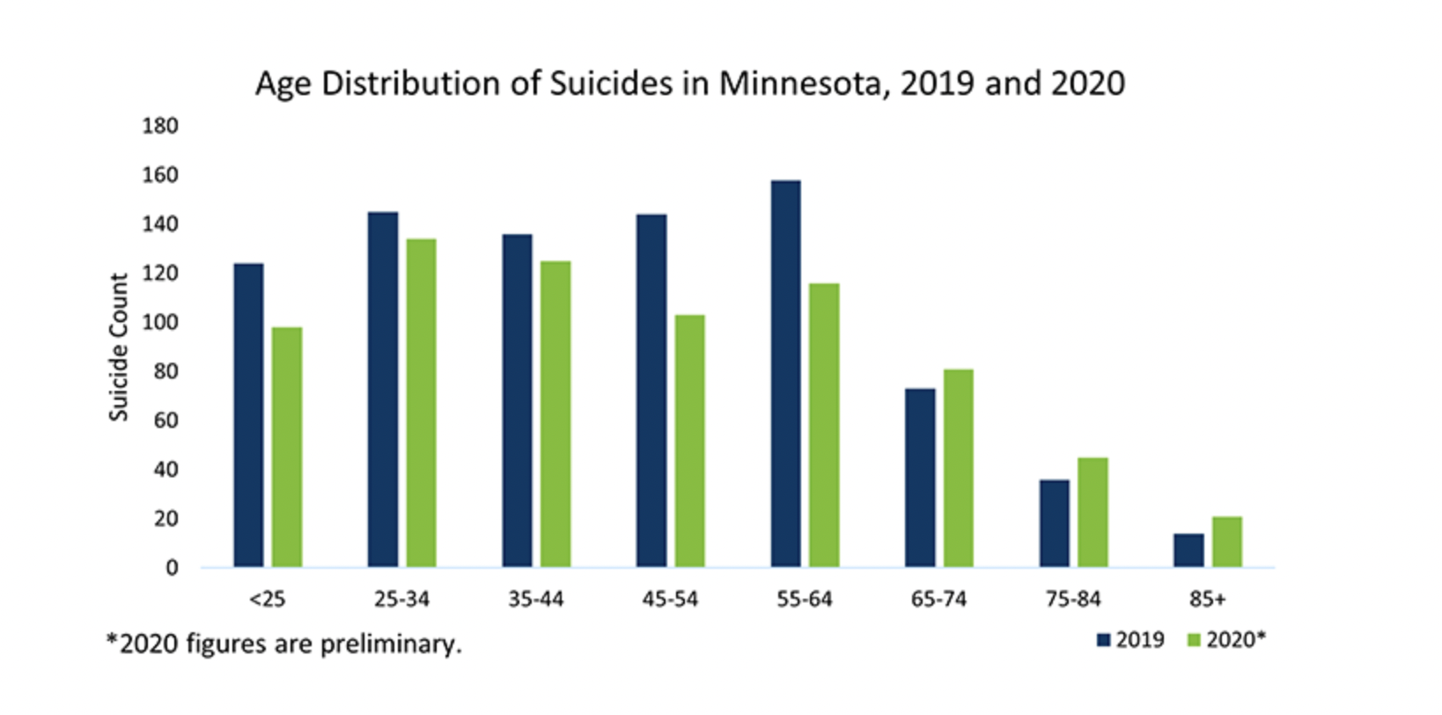
Depression and Risk of Suicide in MN vs Nationally
Men – tied for 37th in US (22.7%)
Women – tied for 35th in US (5.6%)
Overall (65+ years) – tied for 43rd in US (13.5%)

Slide 13
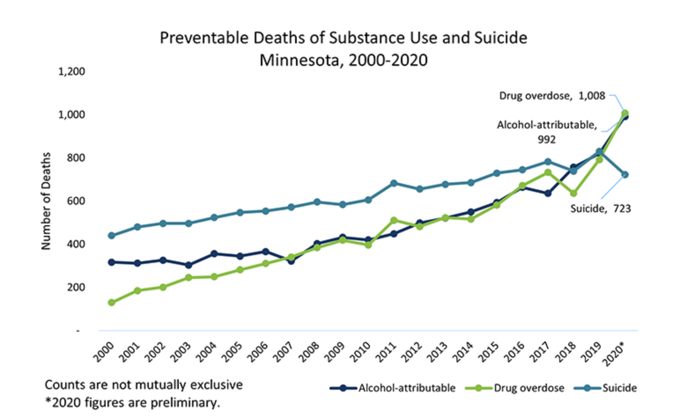
Depression and Risk of Suicide in MN vs Nationally
Comparative look (2011 – 2021, US):
65+ years: 15.3% → 17.3%
85+ years: 16.9% → 22.4%
11th leading cause of death

Slide 14
Statistics in Older Adult Depression
Remains underdiagnosed and inadequately treated or even untreated.
Older men, especially older AA and Hispanic Americans are at even greater risk of unrecognized depression.
Over 80% of mental health treatment for depressed older adults is delivered in the primary care setting.
Depression onset in post-MI patients was associated with fourfold increase in death
Depression onset after a stroke were 3.4 times more likely to have died over 20-year follow-up period.
Decrease in overall risk of death at five years, attributed to fewer cancer deaths, was seen in patients age 60 and older with major depression who were randomly assigned to an intervention to improve depression treatment (involving a care manager), compared to patients assigned to a control group (receiving usual care).

Slide 15
Statistics in Older Adult Depression
The risk of all-cause dementia was greater in subjects with late–life depression than nondepressed controls (risk ratio 1.9). Specifically late life depression was associated with an increased risk of Alzheimers disease and vascular dementia. The elevated risk for all-cause dementia persisted in analyses that included only studies that adjusted for potential confounders (risk ratio 1.6) – 49,000 subjects who did not have dementia at baseline were followed for a median of five years (community-based, observational studies)
The risk of all-cause dementia was increased 70% in subjects who had late life depressive symptoms. Specifically, depression was associated with an increased risk of Alzheimers disease and vascular dementia - >13,500 individuals who did not have dementia at baseline were followed over a six-year period (retrospective study of medical records)
What’s going on here? Late life depression may reflect a prodromal stage of dementia or may act as an independent risk factor for dementia. Additionally, dementia may give rise to episodes of depression.
Dementia syndrome of depression (previously termed “pseudodementia”): Antidepressant treatment can resolve the cognitive and mood symptoms in these patients

Slide 17
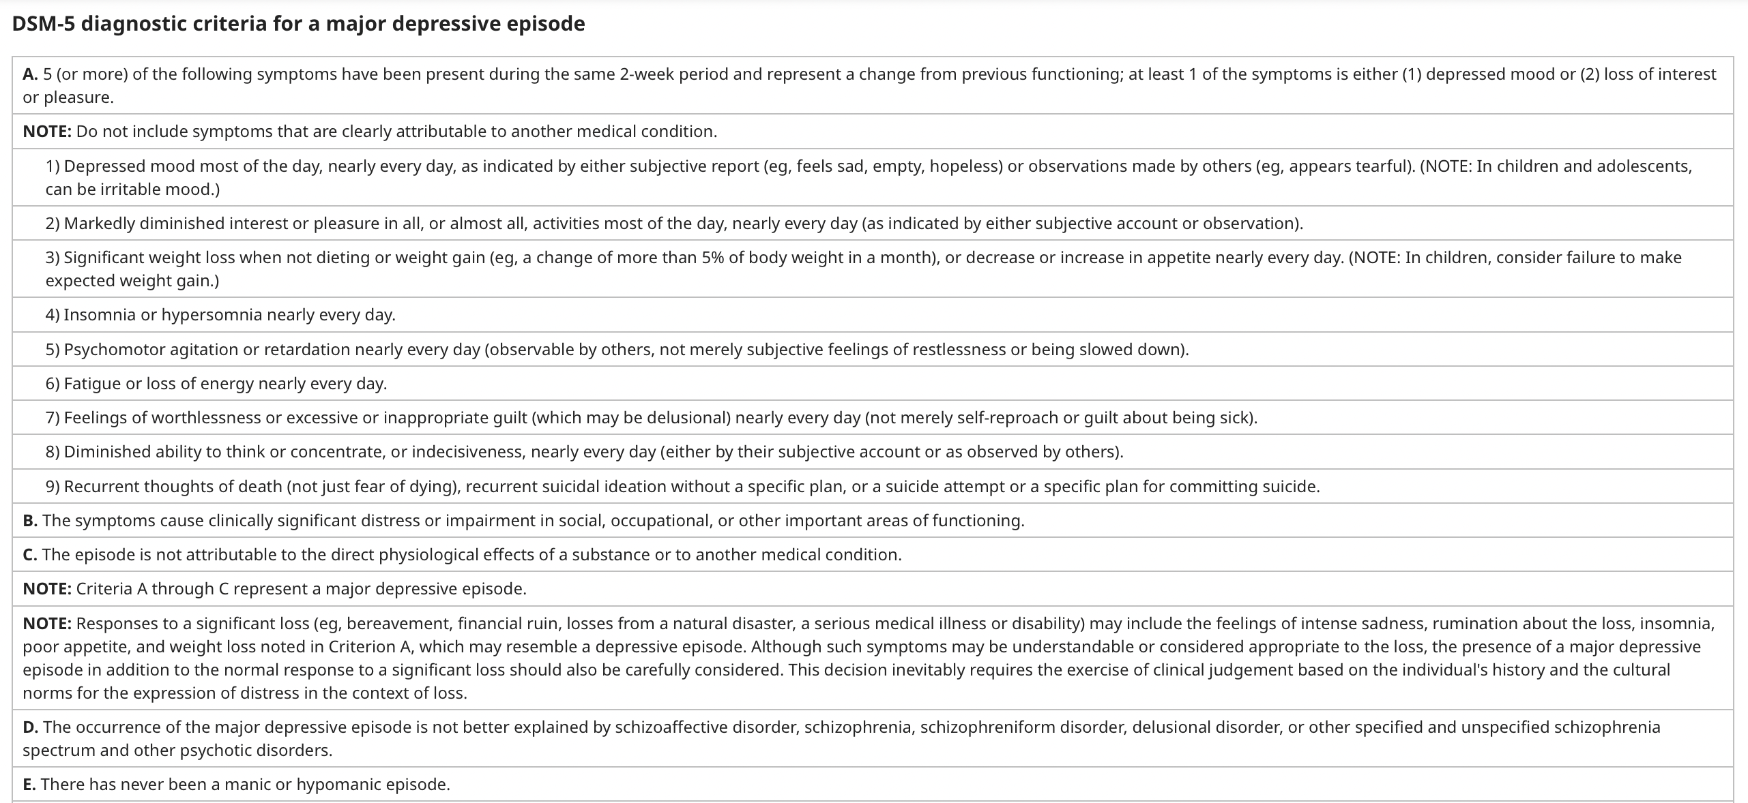

Slide 18
Challenges in Diagnosing Depression in Older Adults
Concurrent medical illness with overlapping symptoms of depression
Medication side effects overlapping depression symptoms
Impaired communication skills in older adults
Presentation with multiple somatic complaints
Lack of time in the clinical exam to evaluate psychological problems in patients with complex medical issues
Therapeutic nihilism regarding depression on the part of the patient, family or provider
Patient reluctance to acknowledge psychological distress due to perceived stigma of mental illness
A few helpful clues when depression should be considered
Mood or somatic symptoms out of proportion to what is expected
Poor response to standard medical treatment
Poor motivation to participate in treatment
Lack of engagement with care providers

Slide 19
Preferred Depression Screening Tool
Screening tools should not be the sole basis for diagnosing depression
Sensitivity should be maximized when choosing a screening tool for depression so that cases are not missed
When screening positive, a clinical diagnostic interview is necessary to determine if criteria for major depression are met
Patient Health Questionnaire 2 (PHQ-2) evaluated in US sample of over 8000 noninstitutionalized adults (age 65+) and was found to have sensitivity 100% and sensitivity 77%!!

Slide 20
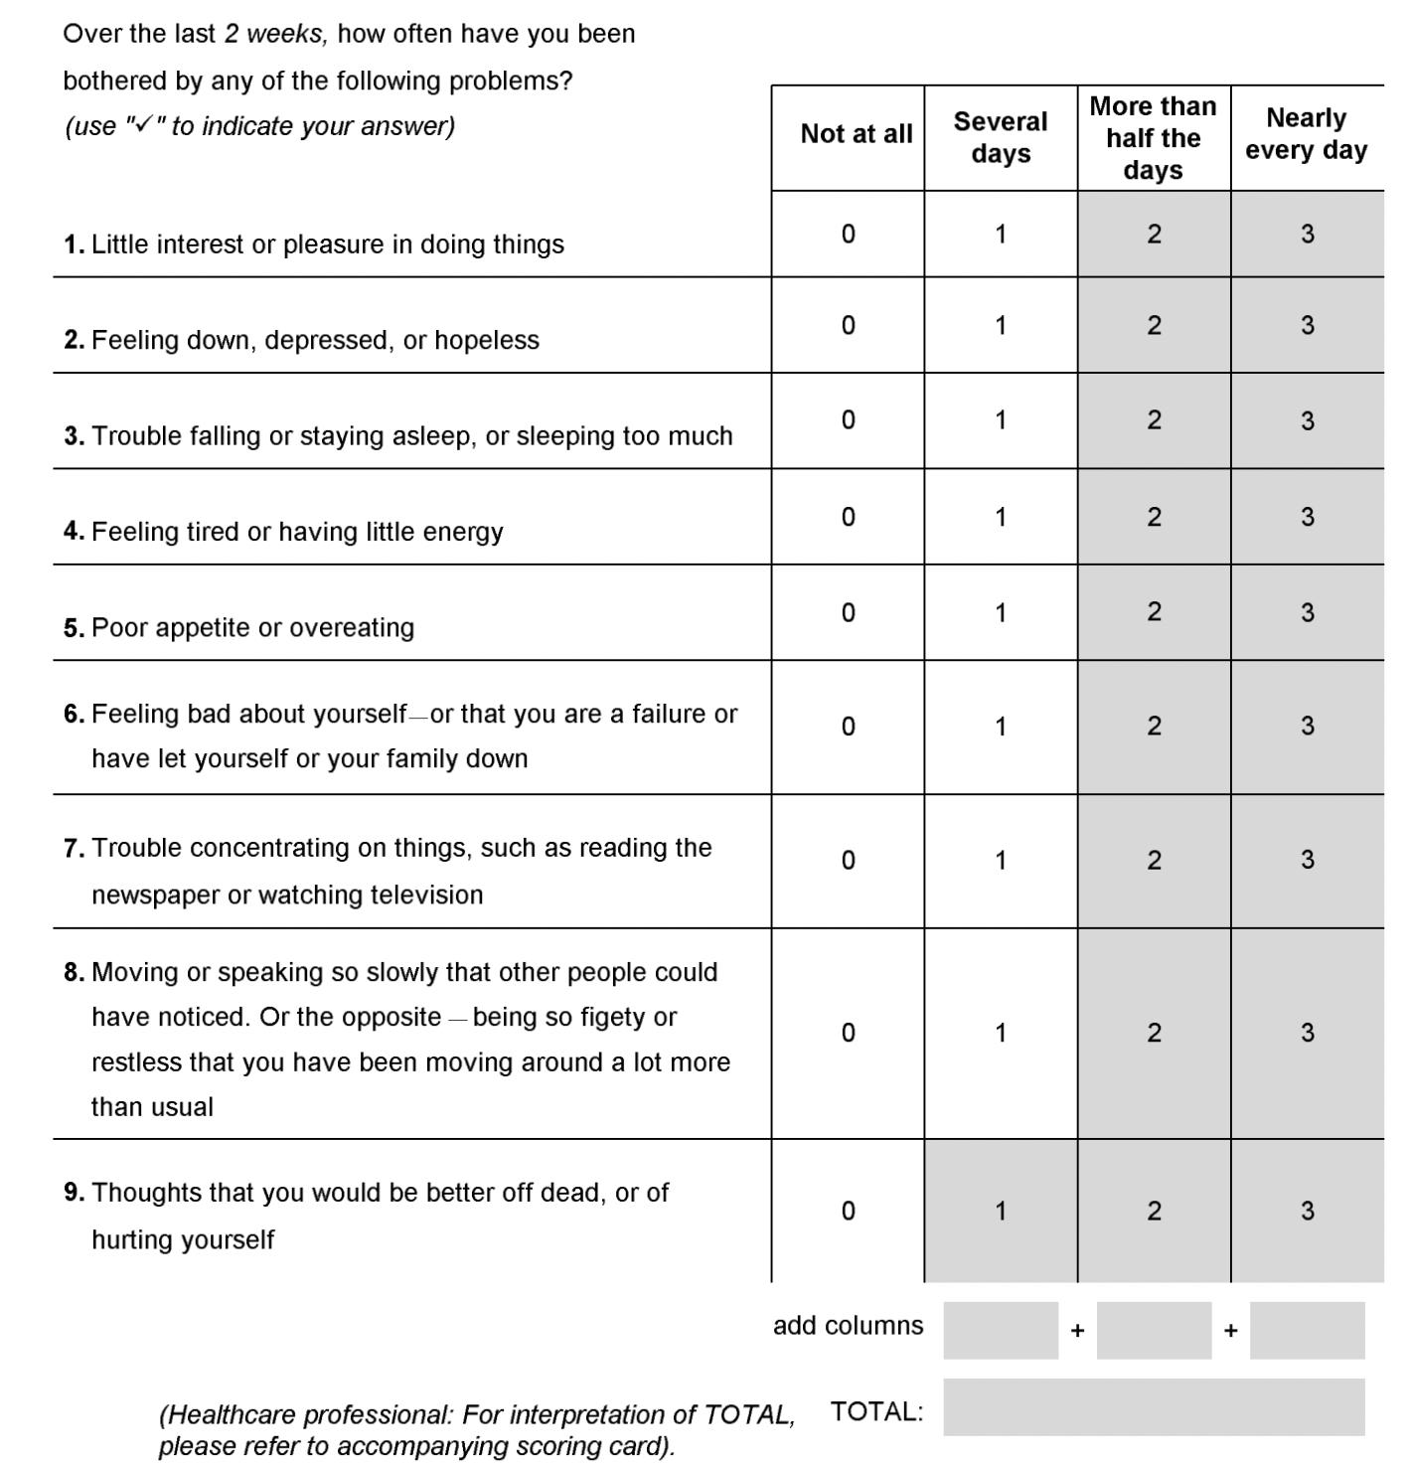
Patient Health Questionnaire - 2
(PHQ-2)
Patient Health Questionnaire - 9 (PHQ-9)

Slide 21
Depression Treatment
Physical Movement/Exercise: 30-minutes per day, most days of the week
Proper nutrition: vary diet with lean meats, fish, fruits, vegetables and whole grains
Avoid alcohol and illicit drugs
Minimize (avoidable) stressors
Family & social support
Pharmacotherapy (SSRIs are first-line)
Psychotherapy (Cognitive-behavioral therapy (CBT), interpersonal psychotherapy, and problem-solving therapy (PEARLS approach) – delivered over a period to 2-4 months can be effective for older adults.
Electroconvulsive therapy (severe and life-threatening, refractory/intolerant to medication(s), does cause transient memory loss)

Slide 22
Problem Solving Therapy
A 12-week trial compared problem-solving therapy with supportive therapy in 221 nondemented patients with major depression and executive dysfunction (difficulty with goal setting and planning, and with initiating and sequencing behavior). Executive dysfunction is associated with poor response to antidepressants. Remission of depression occurred in more patients who received problem-solving therapy compared with controls (46 versus 28 percent). In addition, improvement of disability (self-care, communicating, and psychosocial functioning) was greater with problem- solving therapy, and the advantage was retained at the 24-week follow-up after the end of treatment.
Another 12-week trial compared problem-solving therapy with supportive therapy in 74 patients with major depression and cognitive impairment ranging from mild deficits to moderate dementia. Both interventions were administered weekly in the home. Remission of depression was greater with problem-solving therapy than supportive therapy (38 versus 14 percent). In addition, reduction of disability was greater with problem-solving therapy.

Slide 23
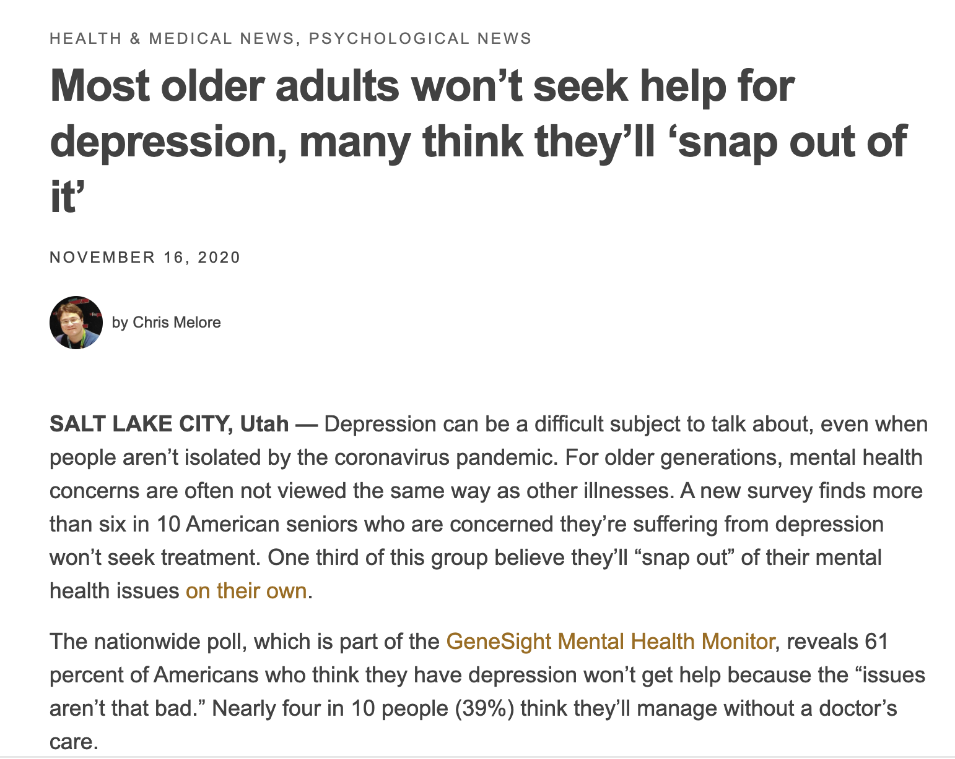
Importance of Educating Older Adults on Depression

Slide 24
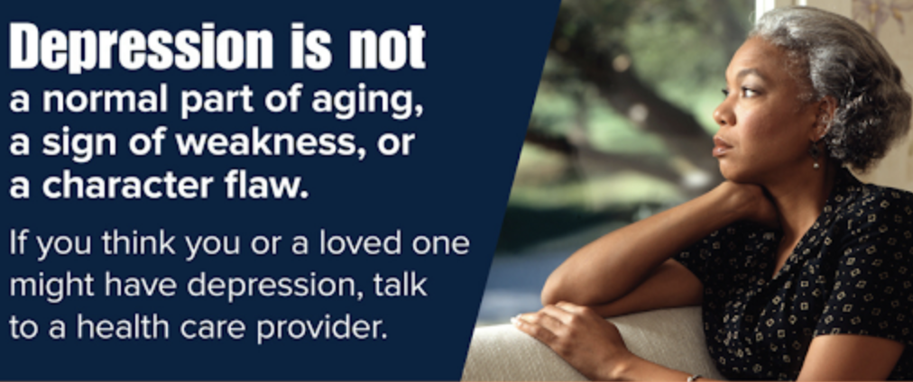
Importance of Educating Older Adults on Depression
Once your depression is properly treated, you can regain your quality of life and even cognitive abilities you might have lost
Seeking treatment is not a sign of weakness or failure
Understand that depression is not a choice
Depression is not something that you can control
Just like you treat diabetes and hypertension, depression requires intervention

Slide 25
Importance of Educating Older Adults on Depression
It’s ok to not be ok (normalize this)
Important to let your family, friends and health-care provider know right away if your experiencing depression symptoms
If you’re having thoughts about suicide or harming yourself, contact a trusted friend, family member or health-care provider immediately
You’re not alone; help is available!

Slide 26
Importance of Educating Older Adults on Depression

Slide 27
Importance of Having a Crisis (Suicide) Protocol
Response in an organized, timely, and compassionate way
Minimize uncertainty and fear
Ideally, crisis (suicide) protocol should cover these key components:
Responding to the acutely distressed or suicidal older adult
Establishing an emergency contact notification procedure (988)
Addressing issues around voluntary and involuntary psychiatric hospitalization
Documenting encounters with the acutely distressed or suicidal older adult
Developing post-crisis follow-up plans

Slide 28
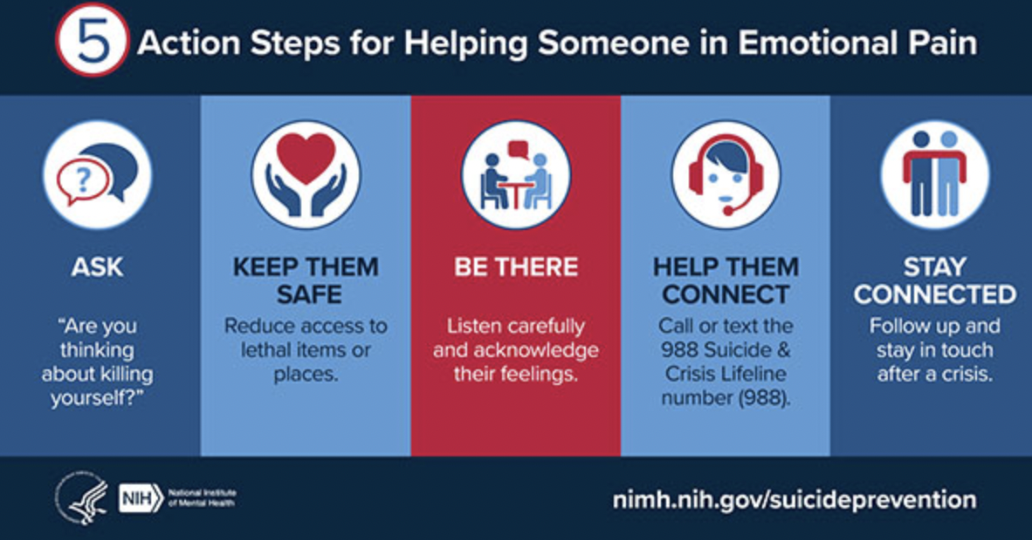
Importance of Having a Crisis (Suicide) Protocol

Slide 29
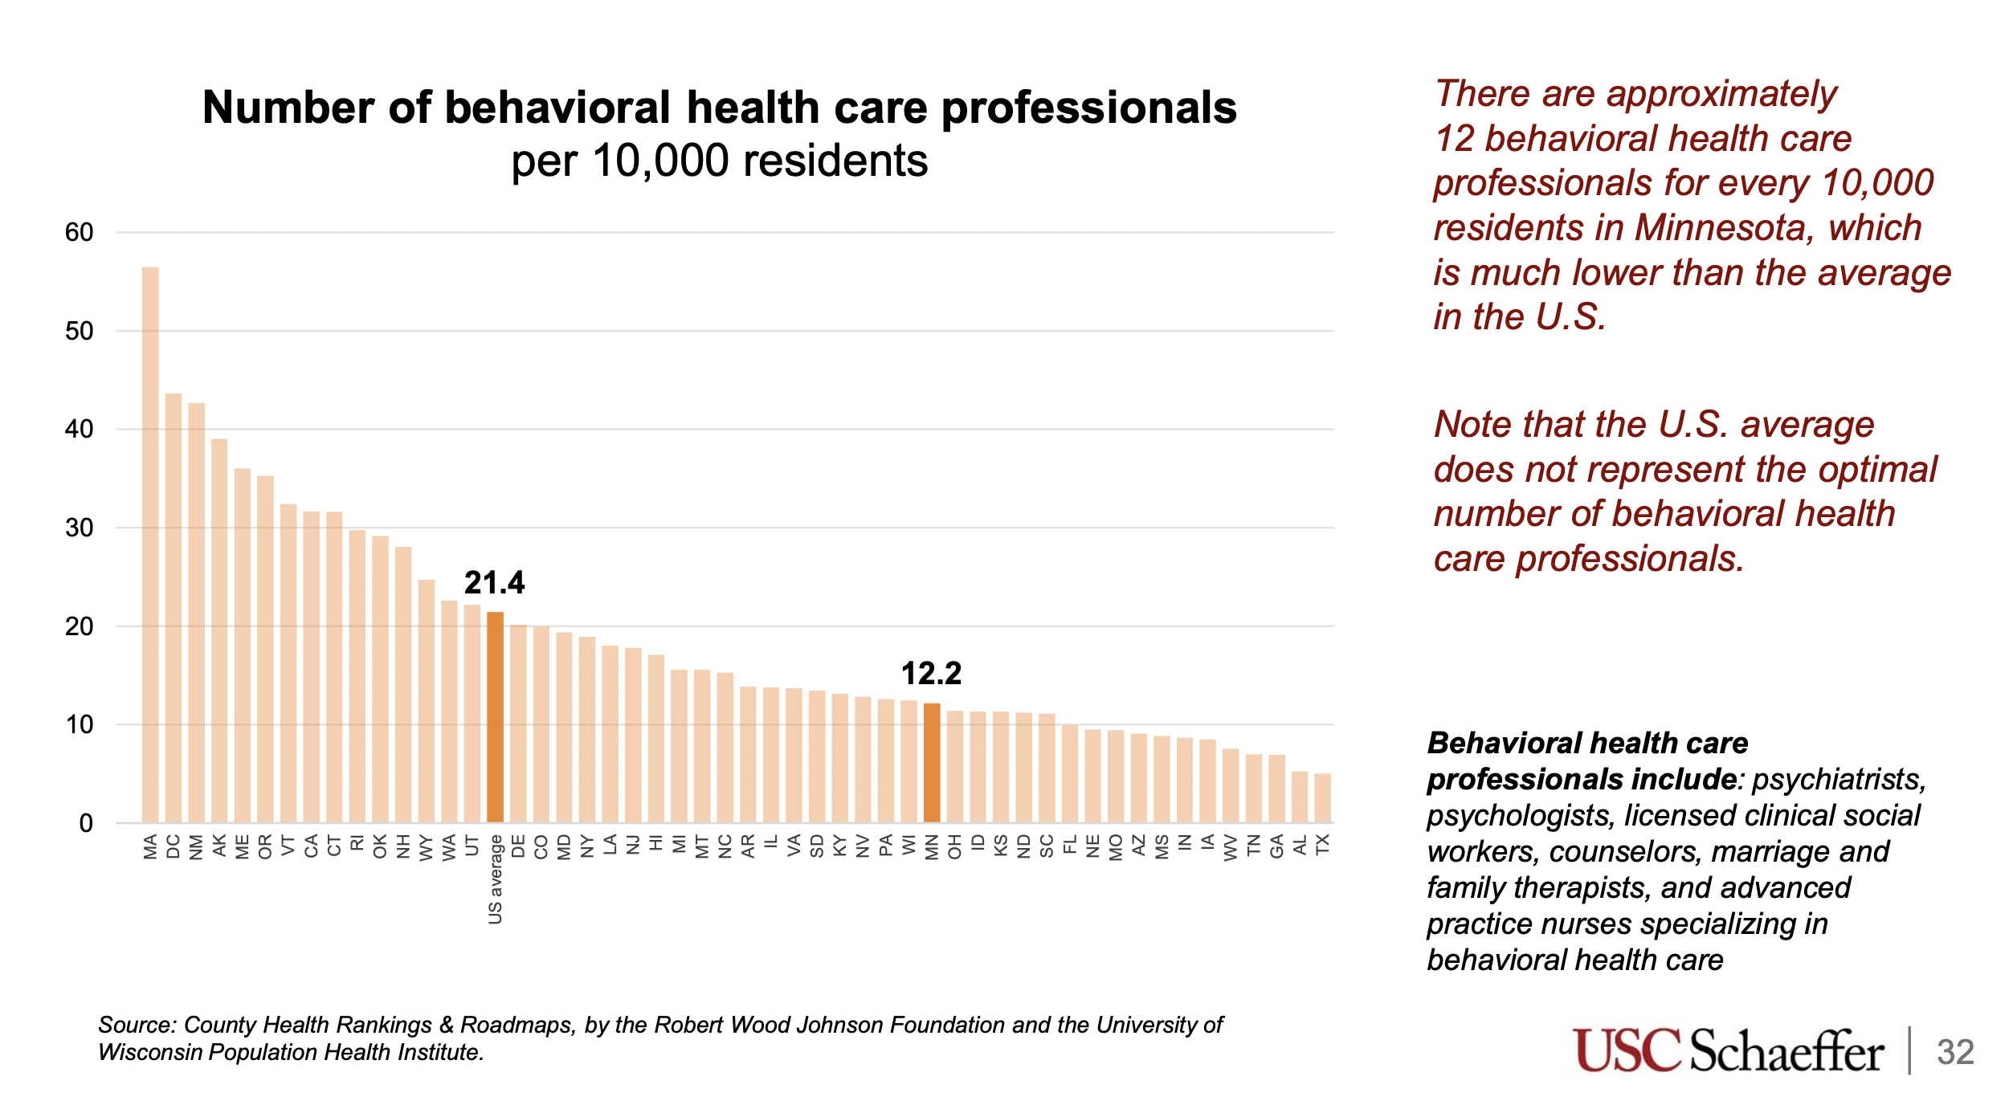
Present Challenges

Slide 30
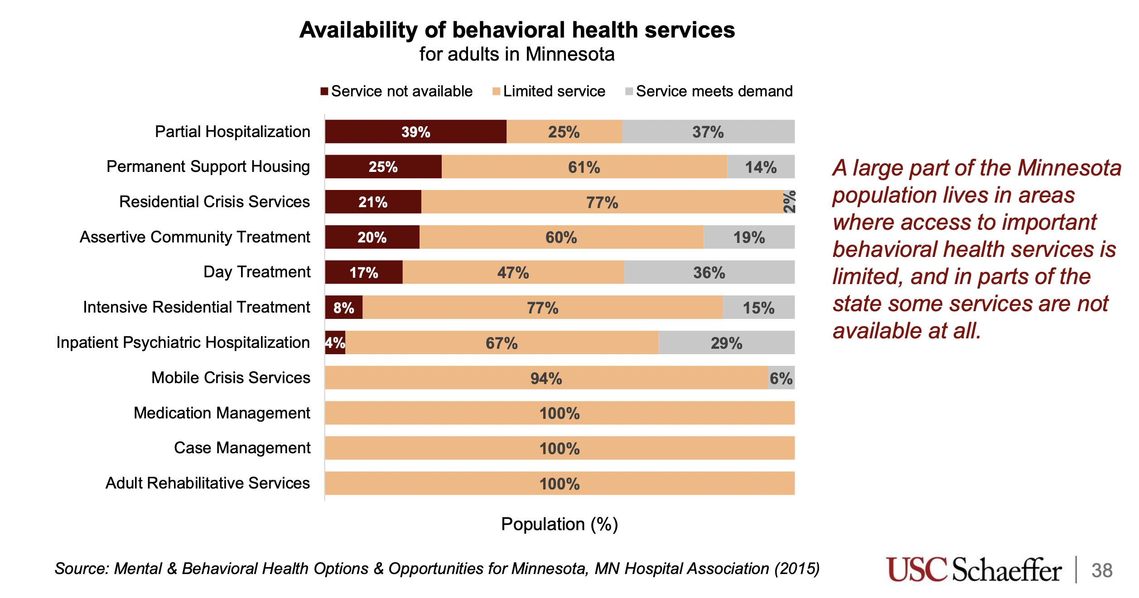
Present Challenges

Slide 31
Resources
National Alliance on Mental Illness MN (NAMI MN) - https://www.namimn.org
Mental Health MN - https://mentalhealthmn.org
Suicide Awareness Voices of Education (SAVE) - https://save.org
MN Department of Health & Human Services - https://mn.gov/dhs/mental-health/
National Institute on Mental Health - https://www.nimh.nih.gov/health/topics/depression
UpToDate, Diagnosis and management of late-life unipolar depression
Prevalence and determinants of depression among old age: A systematic review and meta-analysis. 2021. https://annals-general-psychiatry.biomedcentral.com/articles/10.1186/s12991-021-00375-x
Long-Term Care Medicine: A Pocket Guide, 2011.
Essential Practices in Hospice and Palliative Medicine: Psychiatric, Psychological and Spiritual Care, 5th Ed.

